Slide 1
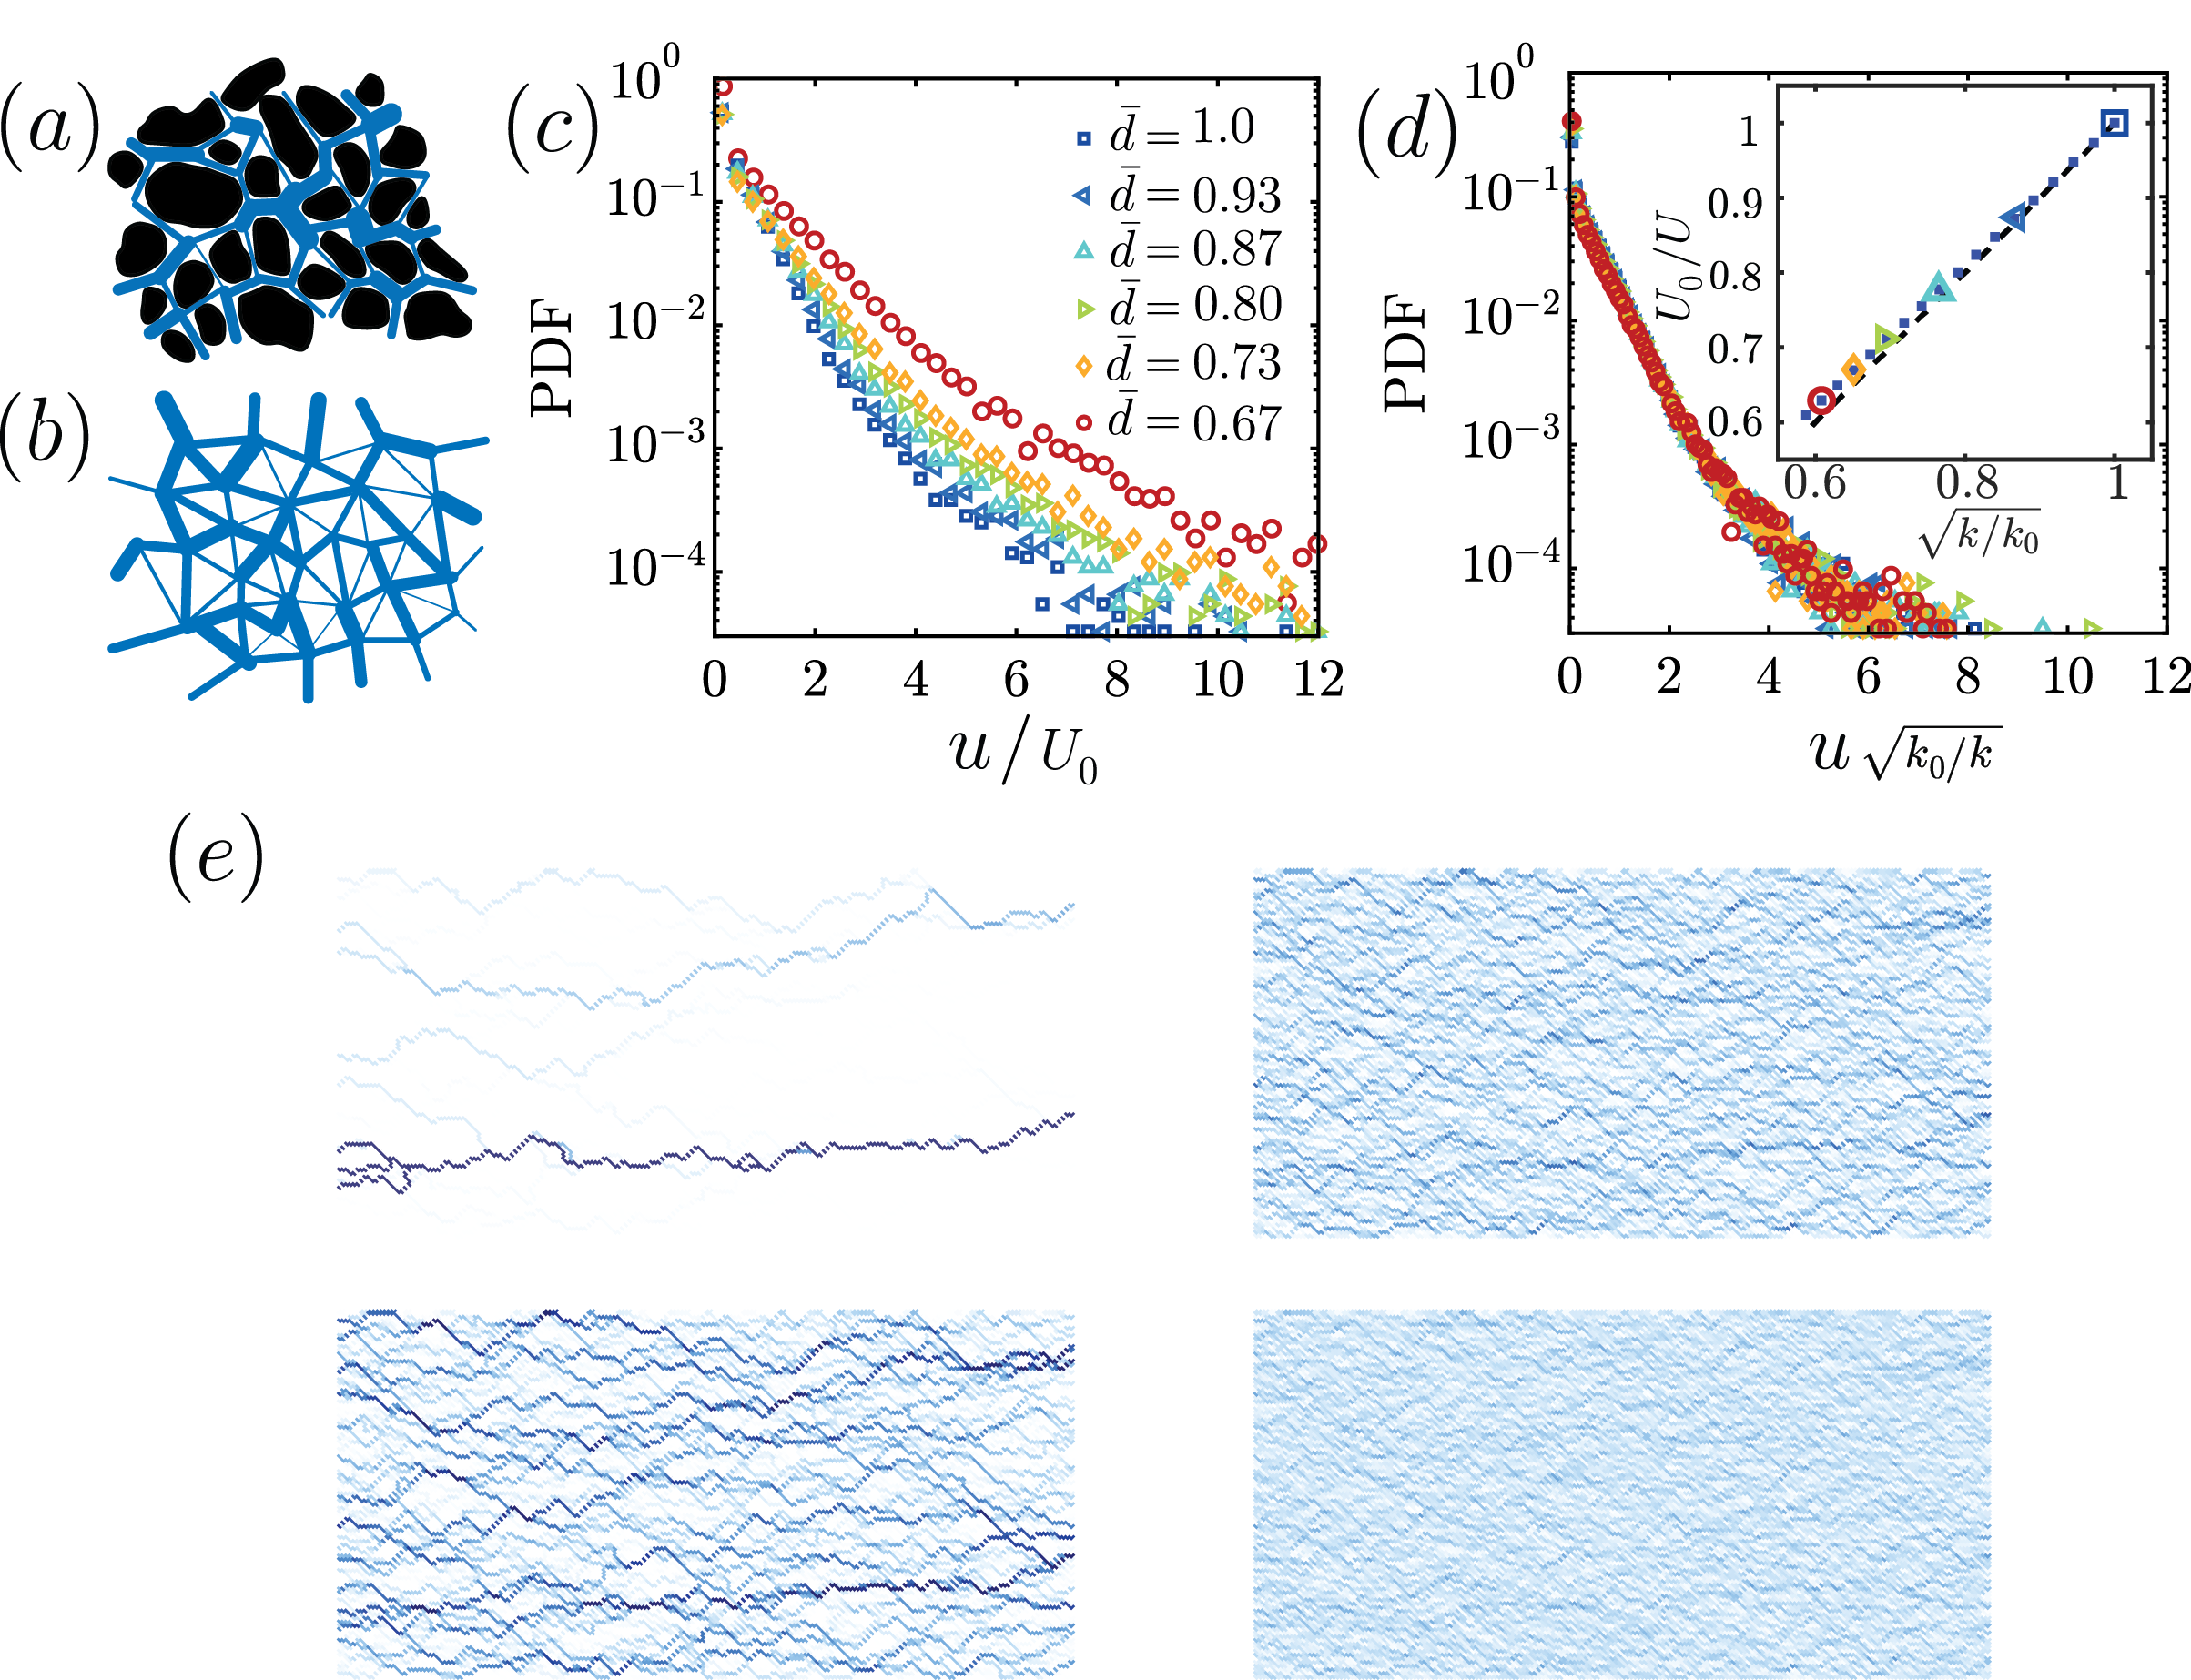
Dynamics of flow-networks in porous media
MRSEC
The flow and transport of fluids and material in porous media is ubiquitous in many industrial and environmental applications such as water filtration, CO2 sequestration, soil remediation, oil recovery, etc. Understanding flow behavior and its dynamics when the pore structure changes dynamically due to the flowing fluids is essential to improve any of the applications.
We model a porous medium as a network of pores connected with cylindrical tubes representing the pore-throats. Using this simplified model, we explain the experimentally observed exponential distribution of local fluid velocity in a disordered porous media. Next, we model dynamical changes in the network by variations in the diameters of the edges. We show that this model explains the experimentally observed changes in pore-level velocity distributions and the scaling with permeability. Furthermore, the network model confirms that the changes in permeability result from changes in network connectivity as the retained polymer begins to block the narrowest tubes successively. Lastly, considering a class of erosion dynamics, the network's long-time behavior can vary between developing channels and instability to becoming homogenized and uniform.
¹A. Zareei, ¹D. Pan, ¹A. Amir, ¹D. Weitz, ²S. Parsa
¹Harvard University, ²Rochester Institute of Technology
Pore-level flow velocity magnitude: (a) Cross-section of a porous media (sandstone) obtained using computerized tomography scan; (b) Schematic of a topologically random network; Probability density function, PDF, of the magnitude of flow velocities: (c) normalized by the average velocity for different values of average tube diameter, (d) normalized by the inverse square root of the permeability. Inset shows the linear relation between relative average velocity and the inverse square root of permeability; (e) different long-time behavior of a porous network depending on various erosion laws, changing from channeling instability (top left) to homogenization (bottom right) indicating the rich physics of a porous network system.
Notes:
<number>

